Slide 1
9 Type of Nonverbal communication

Slide 2
9 types of non-verbal communication
Facial Expression
Gestures
Paralinguistic
Body language and Posture
Proxemics
Eye Gaze
Haptics
Appearance
Artifacts

Slide 3
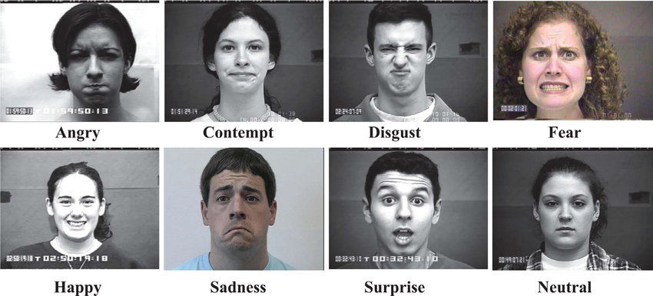
1. Facial Expressions
Facial expressions are responsible for a huge proportion of nonverbal communication. Consider how much information can be conveyed with a smile or a frown. The look on a person's face is often the first thing we see, even before we hear what they have to say.

Slide 4
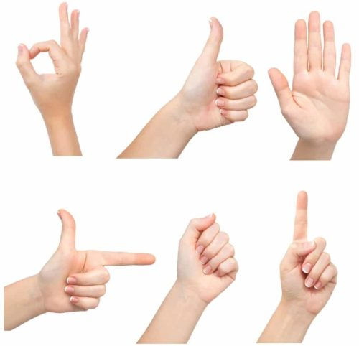
2. Gestures
Deliberate movements and signals are an important way to communicate meaning without words. Common gestures include waving, pointing, and using fingers to indicate numeric amounts. Other gestures are arbitrary and related to culture.

Slide 5
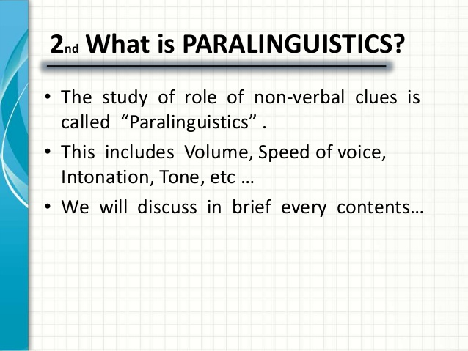
3. Paralinguistic
Paralinguistic refers to vocal communication that is separate from actual language. This includes factors such as tone of voice, loudness, inflection, and pitch. Consider the powerful effect that tone of voice can have on the meaning of a sentence. When said in a strong tone of voice, listeners might interpret approval and enthusiasm. The same words said in a hesitant tone of voice might convey disapproval and a lack of interest.

Slide 6
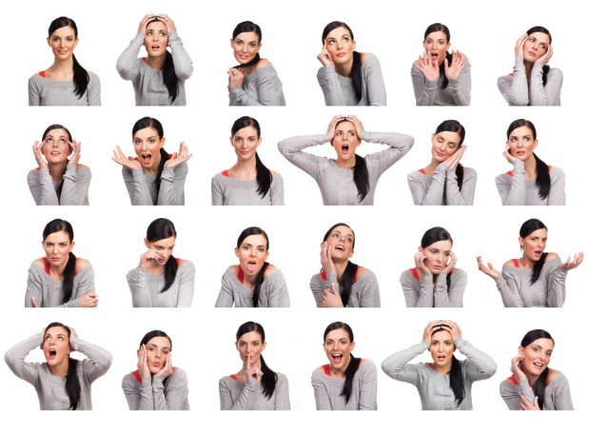
4. Body Language and Posture
Posture and movement can also convey a great deal of information. While these nonverbal behaviors can indicate feelings and attitudes, research suggests that body language is far more subtle and less definitive than previously believed.

Slide 7
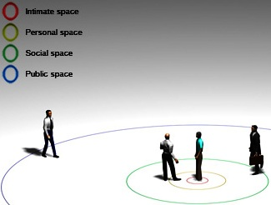
5. Proxemics
People often refer to their need for "personal space," which is also an important type of nonverbal communication, aka Proxemics, influenced by a number of factors including social norms, cultural expectations, situational factors, personality characteristics, and level of familiarity.

Slide 8
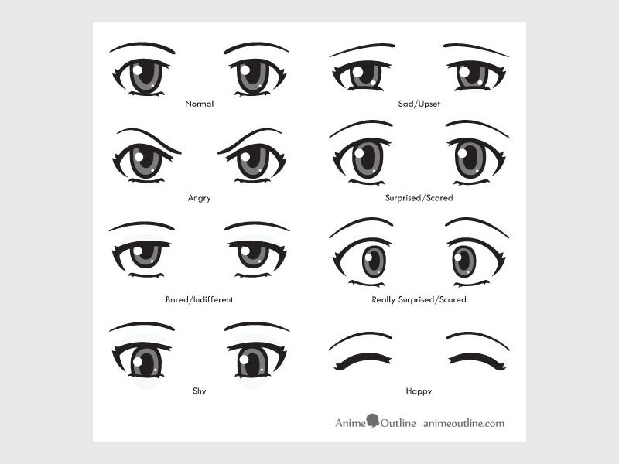
6. Eye Gaze
Looking, staring and blinking are the common nonverbal behaviors. Looking at another person can indicate a range of emotions including hostility, interest, and attraction. steady eyes contact are a sign for telling the truth and shifty eyes are seen as lying.

Slide 9
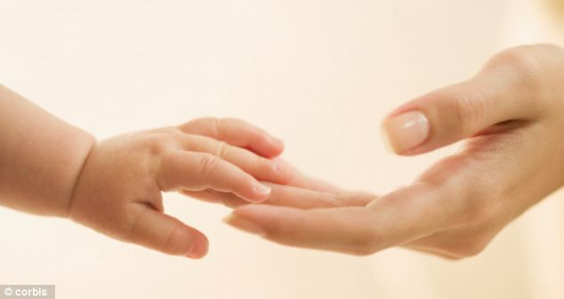
7.Haptics
.Communicating through touch is another important nonverbal behavior. Touch can be used to communicate affection, familiarity, sympathy, and other emotions. “Women tend to use touch to convey care, concern, and nurturance. Men, on the other hand, are more likely to use touch to assert power or control over others.”

Slide 10
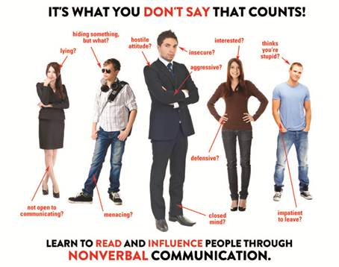
8. Appearance
. Our choice of color, clothing, hairstyles, and other factors affecting appearance are also considered a means of nonverbal communication. Appearance can also alter physiological reactions, judgments, and interpretations. These first impressions are important, which is why experts suggest that job seekers dress appropriately for interviews with potential employers.
Culture is also an important influence on how appearances are judged. While thinness tends to be valued in Western cultures, some African cultures relate full-figured bodies to better health, wealth, and social status.

Slide 11

9. Artifacts
Objects and images are also tools that can be used to communicate nonverbally. People often spend a great deal of time developing a particular image and surrounding themselves with objects designed to convey information about the things that are important to them.
For example, Uniforms can be used to transmit a tremendous amount of information about a person. A soldier will don fatigues, a police offers will wear a uniform, and a doctor will wear a white lab coat. At a mere glance, these outfits tell people what a person does for a living.

Slide 12

Thanks for paying attention

